Slide 1

The Art of Word Guessing: A Python Hangman Game
A Course Project for ENGR 499: Advanced Software Design, 2024
Team Members
Faculty Supervisor
Vaibhavi Shinde , M. Rebekah , J. Princess Liza
Jabiulla sir and Usman sir
Course & Batch
Python course, Batch-A

Slide 2

Project Overview: Building a Classic Game
This project involves the design, development, and implementation of a fully functional, console-based Hangman game using Python.
The core purpose was to apply fundamental object-oriented programming (OOP) principles and file handling techniques in a practical, engaging application. It serves as a comprehensive demonstration of basic software development lifecycle skills.
Focus
Outcome
Console application development and core Python programming.
A robust, interactive word-guessing game with a dynamic difficulty system.

Slide 3


The Problem Statement: Engaging Programming Practice
The Challenge
Our Approach
How can students effectively demonstrate mastery of intermediate Python concepts, such as data structures, exception handling, and modular programming, through a unified and measurable project?
Developing a familiar game like Hangman requires integrating several different programming components—from input validation to state management—in a cohesive system, providing a perfect testbed for these skills.
Focusing on a well-defined project like a game ensures that all team members are working towards clear, functional milestones that can be easily tested and evaluated.

Slide 4





Project Objectives and Expected Outcomes
Code Efficiency
Develop a clean, well-commented codebase adhering to PEP 8 standards.
User Interactivity
Implement an engaging, intuitive command-line interface (CLI).
Modular Design
Separate game logic (core functionality) from presentation (CLI graphics).
Persistent Data
Utilise file I/O to manage an extensive, dynamic word list.

Slide 5








Proposed System: The Hangman Game Core
Our solution centres on three primary components that manage the game state, user interaction, and data handling.
Game Manager
User Interface
Handles the overall game loop, including starting new games, tracking turns, and determining win/loss conditions.
Manages all console input and output, displaying the current state of the word, guessed letters, and the Hangman figure itself.
Input Validator
Word Selector
Ensures all user input is a single, unique, lowercase alphabetical character, preventing game crashes due to bad data.
Reads a database of words from a .txt file and randomly selects a word, ensuring variety.

Slide 6





System Architecture & Workflow
The system operates in a clear, sequential cycle, ensuring robust game management from start to finish.
Player Input
Initialise
Game Logic
Output & Loop
This cyclic design allows for easy expansion in the future, such as adding new game modes or scoring mechanisms, without fundamentally altering the core logic.

Slide 7




Key Features: Enhancing the Gameplay
Our implementation goes beyond basic functionality by incorporating elements designed for enhanced user engagement and code quality.
Dynamic Visuals
Word Management
The Hangman graphic is rendered incrementally in the console, providing clear visual feedback on the number of remaining attempts.
Words are loaded from an external file, making it easy to update the dictionary without modifying the source code.
Replay Functionality
Robust Error Handling
At the end of each round, the player is prompted to start a new game, ensuring continuous engagement.
Extensive try-except blocks handle invalid input, ensuring the game does not crash under unexpected user behaviour.

Slide 8
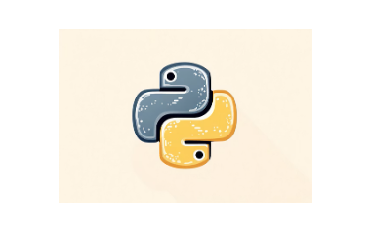
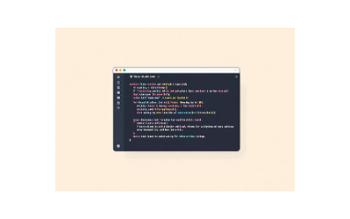

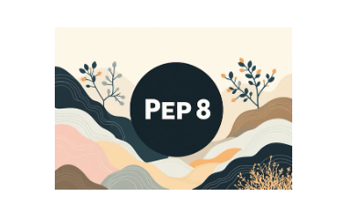
Technology Stack and Development Tools
The project was exclusively developed using industry-standard tools and the powerful capabilities of Python.
Primary Language
Python 3.10+
Development Environment
Visual Studio Code (VS Code)
Version Control
Git & GitHub for collaborative development and tracking changes.
Dependencies
Only standard Python libraries (e.g., random, os) were used, maintaining simplicity and portability.

Slide 9
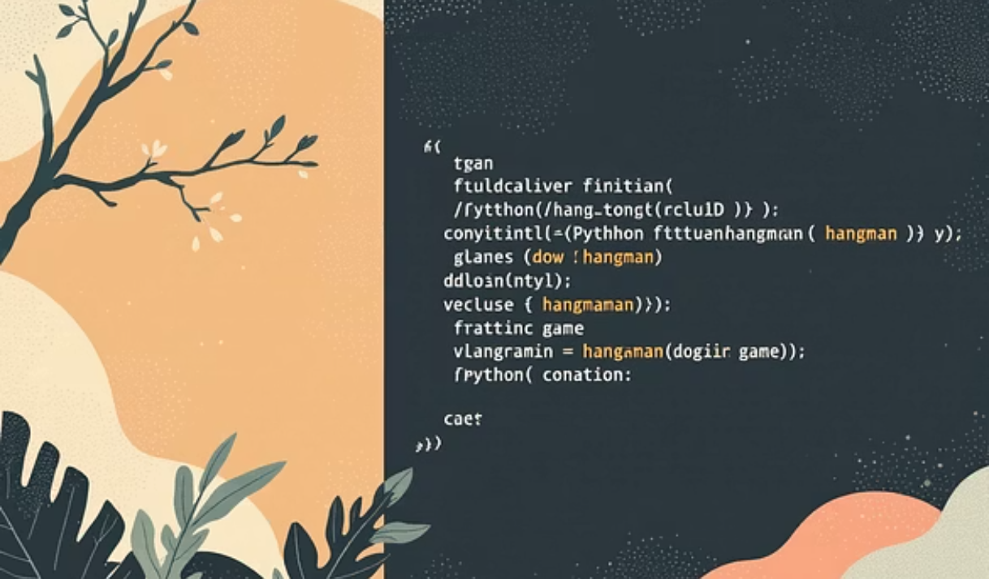
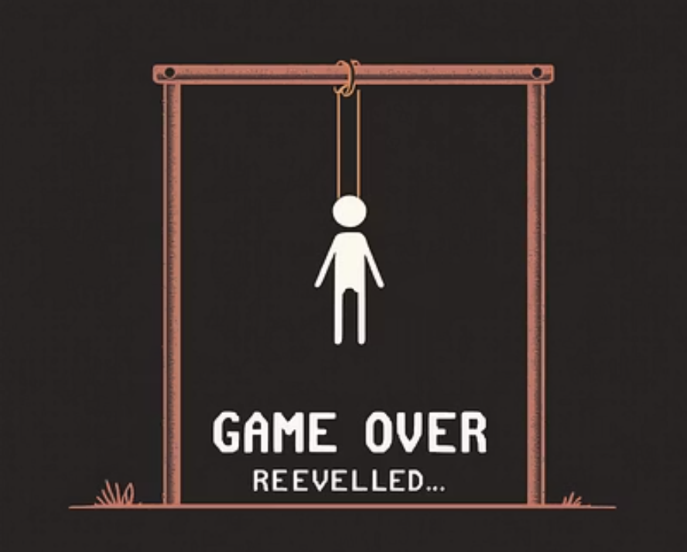
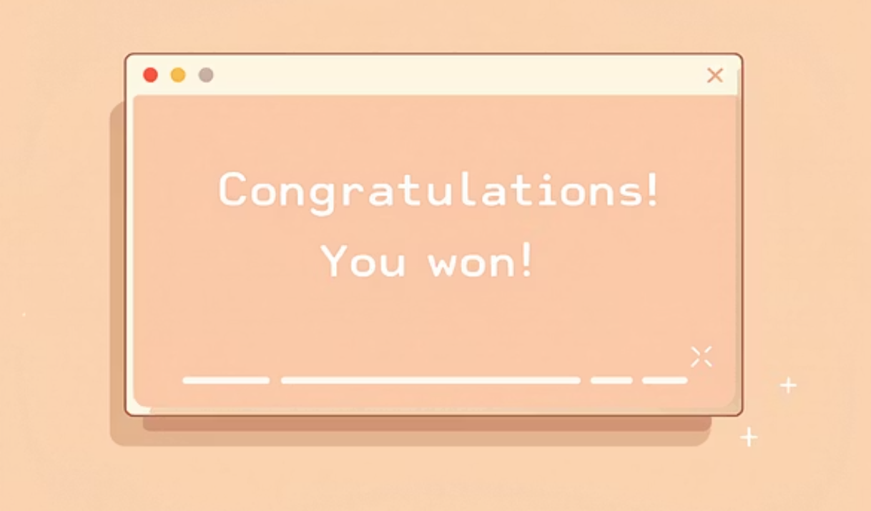
Implementation Snapshot: Code and Console Output
Visual examples demonstrating the key elements of our Python implementation and the game's dynamic console rendering.
The core function for checking user input is highly optimised, running in O(1) time complexity by using Python sets for efficient lookups of guessed letters.

Slide 10
Challenges Encountered and Solutions
Developing the game presented several technical challenges, primarily related to maintaining state and handling user error.
Challenge: Console Visualisation
Challenge: Input Sanitisation
Updating the ASCII Hangman figure and word display efficiently without flickering.
Preventing non-alphabetical characters or multiple letters from breaking the game loop.
Solution: State Mapping
Solution: Regular Expressions
Implemented a dictionary mapping the number of incorrect guesses to pre-defined ASCII art stages, rendering the full state in one go.
Used a small regular expression pattern to strictly validate input against single, lowercase letters before processing the guess.

Slide 11

Team Contribution🧑‍💻
Vaibhavi – Designed the GUI and integrated word & hint system.
Rebekah – Developed the main game logic and scoring system.
Liza – Tested the game and prepared the final project report.

Slide 12
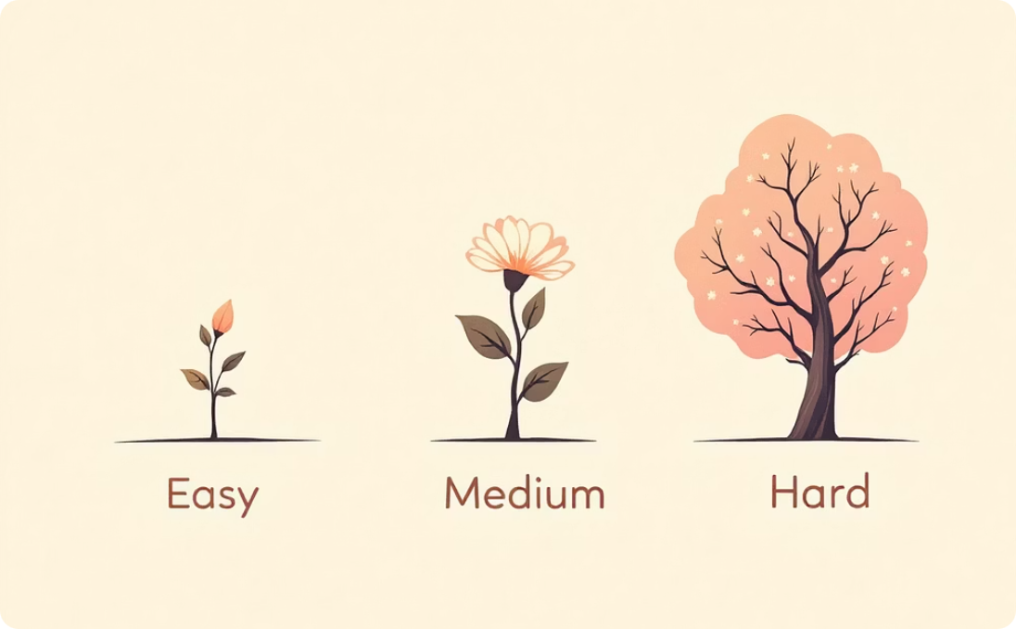
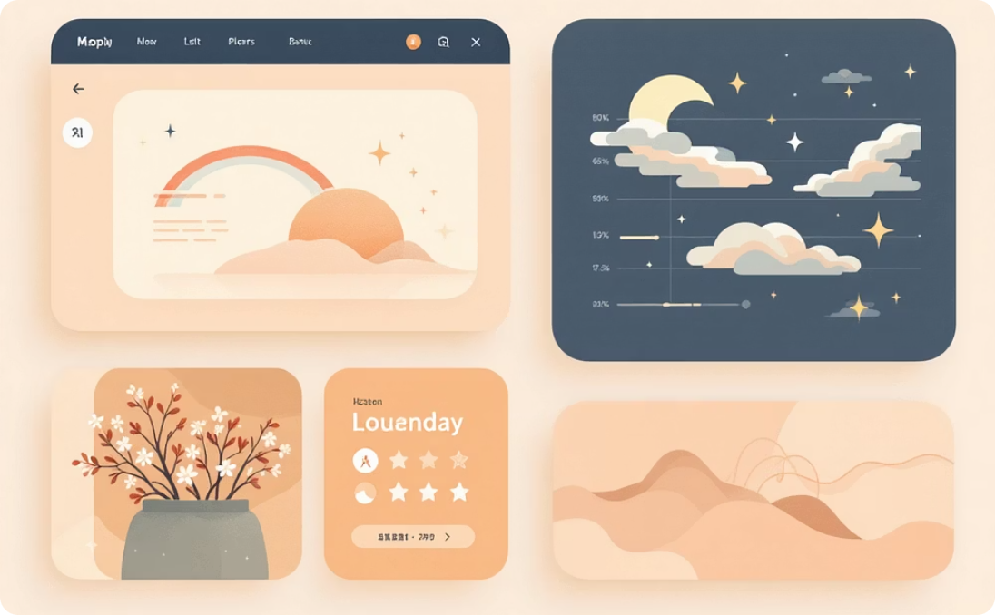
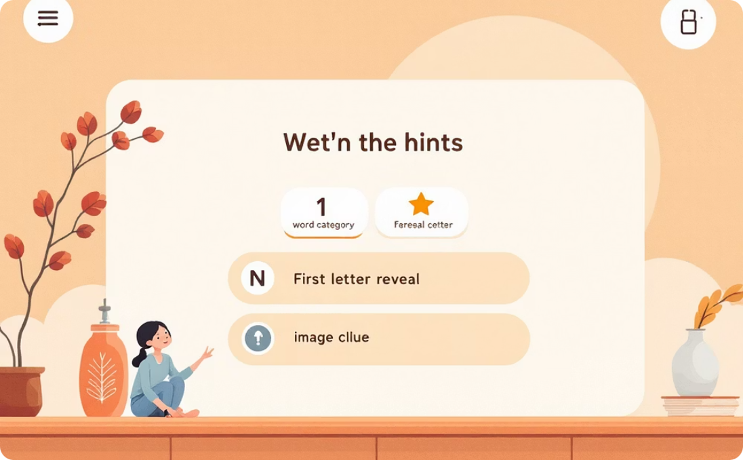
Future Enhancements
1. Add Difficulty Levels
2. Improved GUI Design
3. More Hints / Clues
Introduce Easy, Medium, and Hard levels to tailor the challenge for players.
Enhance the visual appeal and user experience with a modern interface.
Offer diverse assistance options to help players solve challenging words.
Easy: shorter words, more chances.
Use libraries like Tkinter, PyQt, or Pygame.
Provide multiple hints (e.g., word category, first letter, image clue).
Hard: longer words, fewer hints or limited tries.
Integrate animations, smooth transitions, attractive fonts, colors, and buttons.
Allow users to “buy” hints by sacrificing points or tries.

Slide 13

Conclusion and Thank You
Conclusion:
The Hangman Game successfully demonstrates the use of Python programming and GUI development using Tkinter.
It provides an interactive and educational experience for users to improve their vocabulary and guessing skills.
The project helped us understand game logic, event handling, and user interface design in Python.
Learnings:
Gained hands-on experience in Python programming and GUI implementation.
Improved teamwork, problem-solving, and debugging skills.
Learned how to structure a complete software project — from coding to presentation.
🙏 Thank You
Thank you to our faculty guide for continuous support and guidance.
Thank you everyone for your time and attention!

